Slide 1
LA Crime Analysis Unveiling The Underlying Crime Trends, Patterns, And Understanding Impact Of Major Events Like Covid, Elections Using Data-driven Techniques.
Shri Krishna
DS5B-2133
M.Sc (D.S.A)

Slide 2

LOS ANGELES CRIME ANALYSIS
PROBLEM STATEMENT:
Los Angeles often referred to by its initials L.A. is the commercial, financial, and cultural center of Southern California.
Los Angeles has the third largest police department in the USA, with jurisdiction over almost 4 million people.
The city of Los Angeles (LA) faces the challenge of effectively analyzing and understanding crime patterns to enhance public safety and allocate resources efficiently.
There is a need to develop a comprehensive analysis framework that enables stakeholders to gain insights into crime trends, identify high-crime areas.

Slide 3
Project analysis slide 3
Approach to Solution
EXPLORATORY DATA ANALYSIS
COMPARATIVE ANALYSIS OF CRIME
PART 1 & 2 CRIMES CLASSIFICATION
IMPACT OF GLOBAL EVENTS ON CRIME
EDA provided valuable visualizations and statistical summaries, highlighting crime trends, seasonal patterns, and correlations between various crime attributes .
Comparison of LA Crime between 2020-Present and 2010-2019 helps in examining variations of crime rates across areas, demographics and time periods..
Part 1 and Part 2 crimes are classifications used by law enforcement agencies, including the Los Angeles Police Department (LAPD), to categorize different types of crimes.
To understand global impact on day to day crimes. We consider these events:
Covid-19 Pandemic.
George Floyd Protests.
2020 US Presidential Elections.

Slide 4
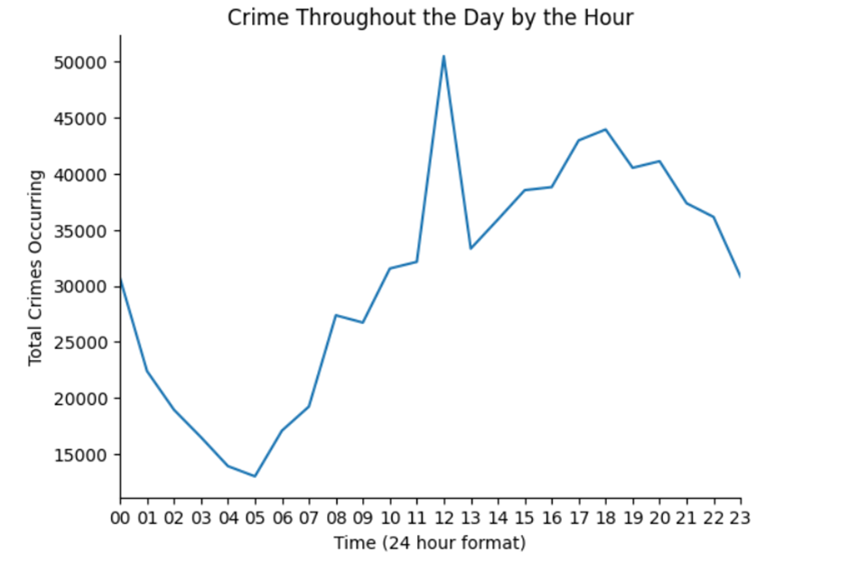
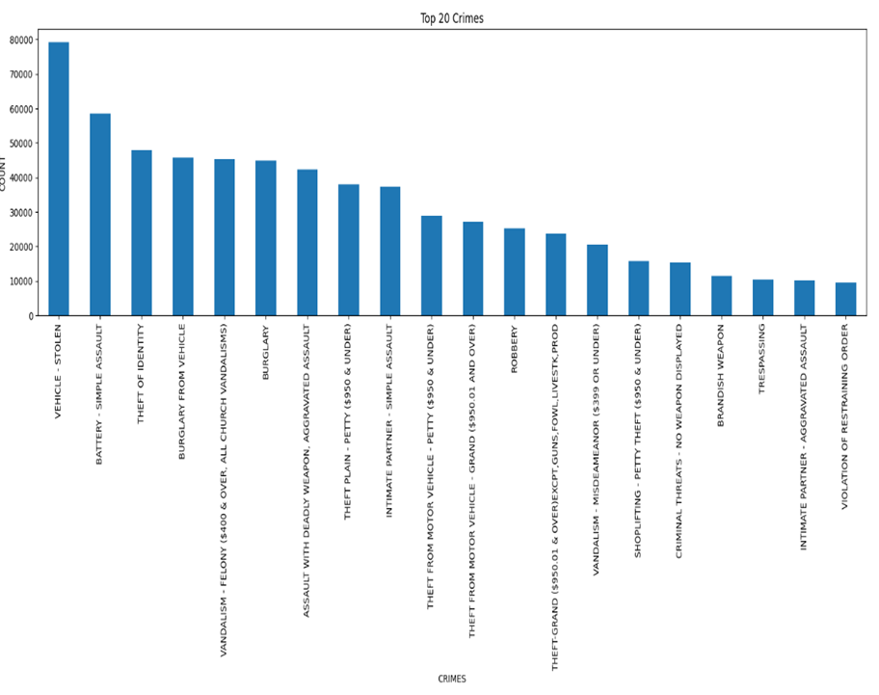
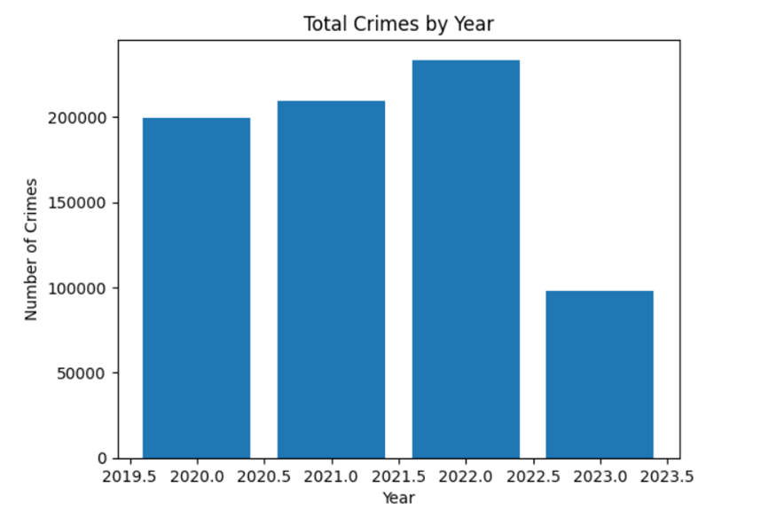
EXPLORATORY DATA ANALYSIS OF LA CRIME (2010-PRESENT) :

Slide 5
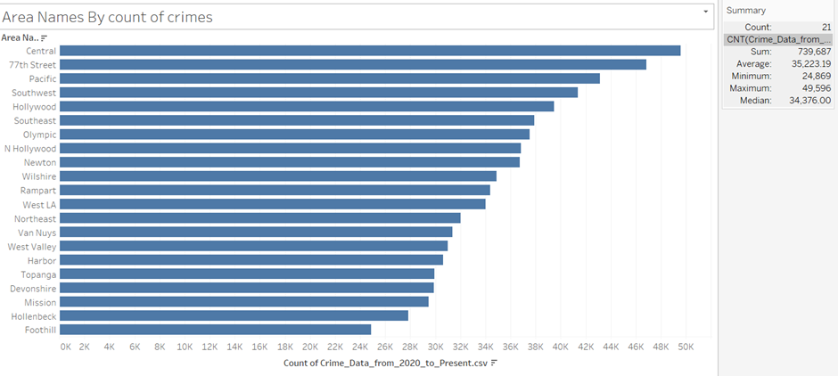
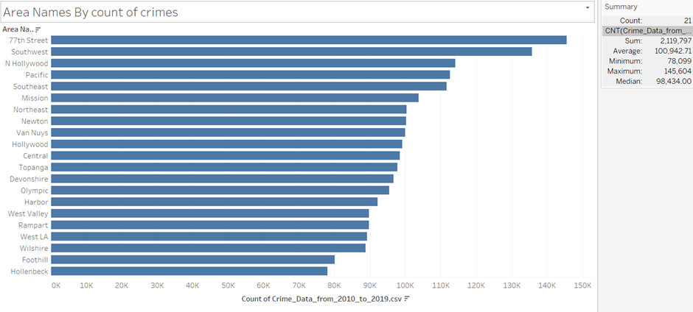
Comparison of crimes in L.A. between two time periods
Crime between (2020-Present)
Crime between (2010-2019)

Slide 6
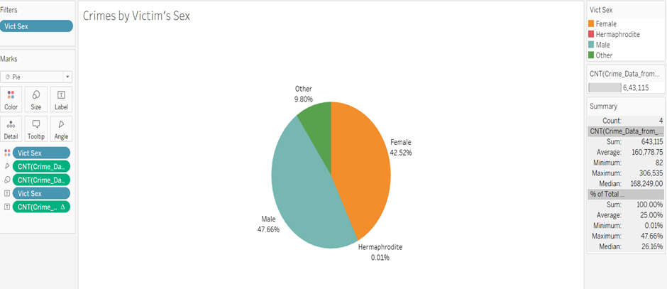
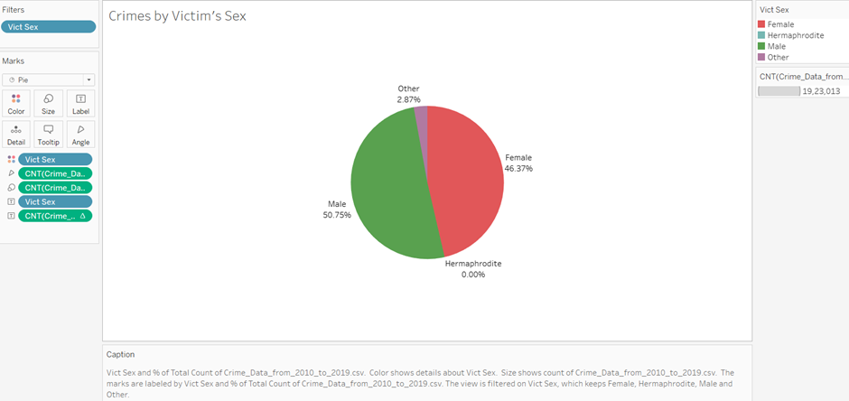
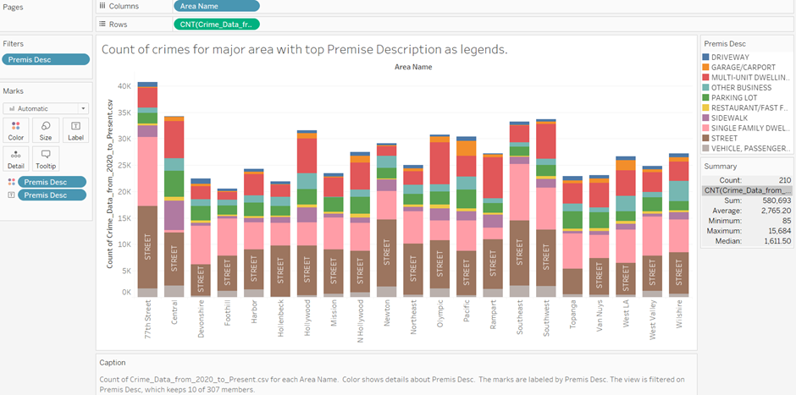
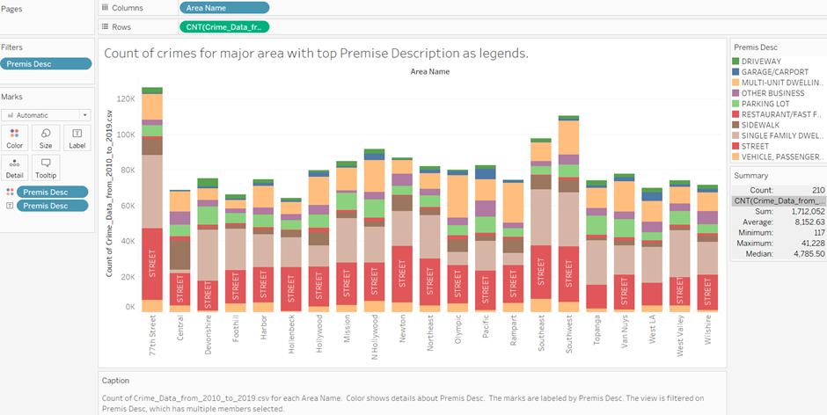
Crime between (2020-Present)
Crime between (2010-2019)

Slide 7
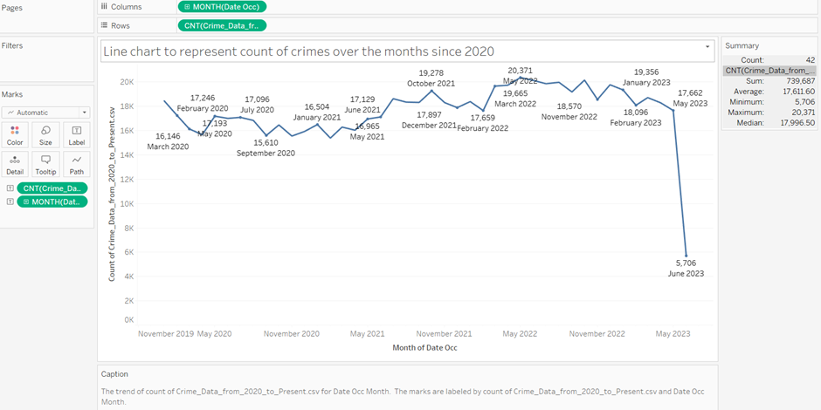
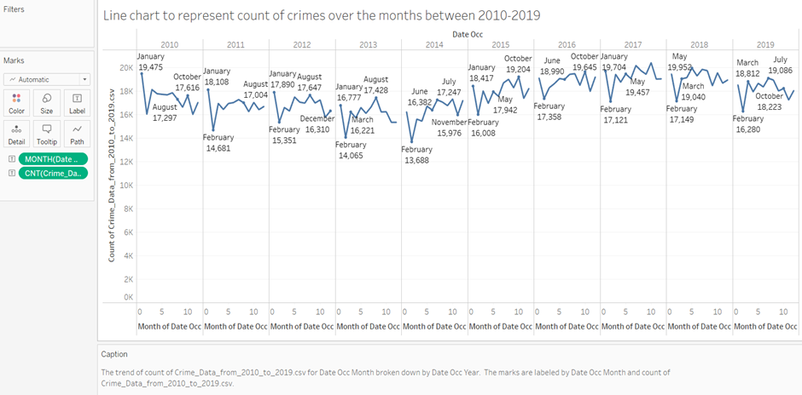
Crime between (2020-Present)
Crime between (2010-2019)

Slide 8
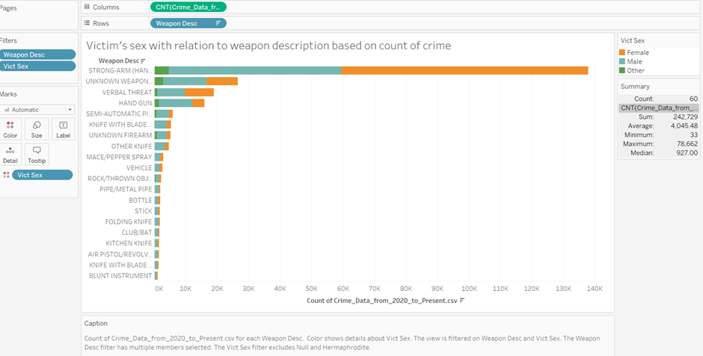
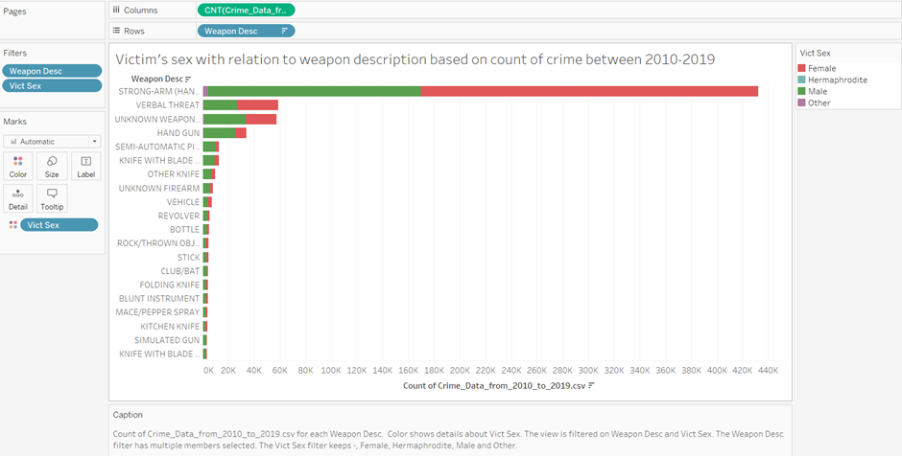
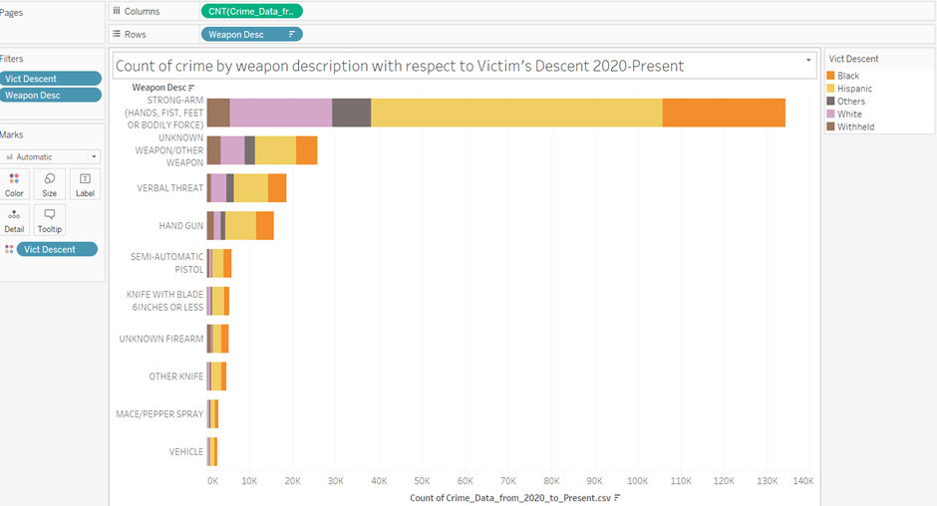
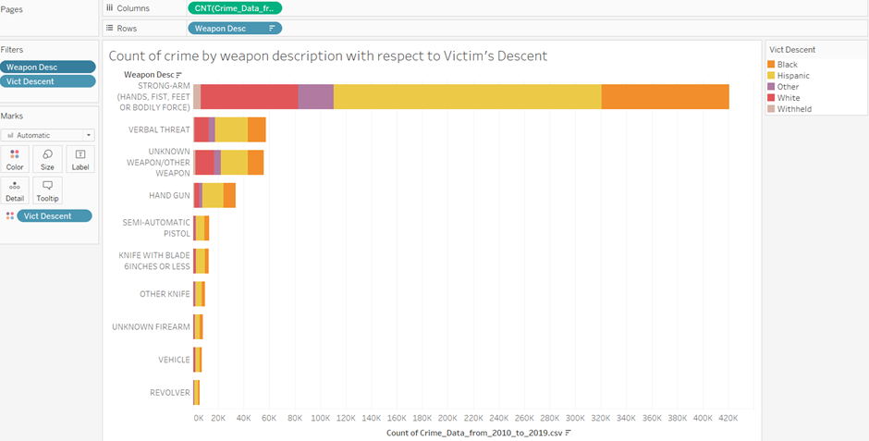
Crime between (2020-Present)
Crime between (2010-2019)

Slide 9
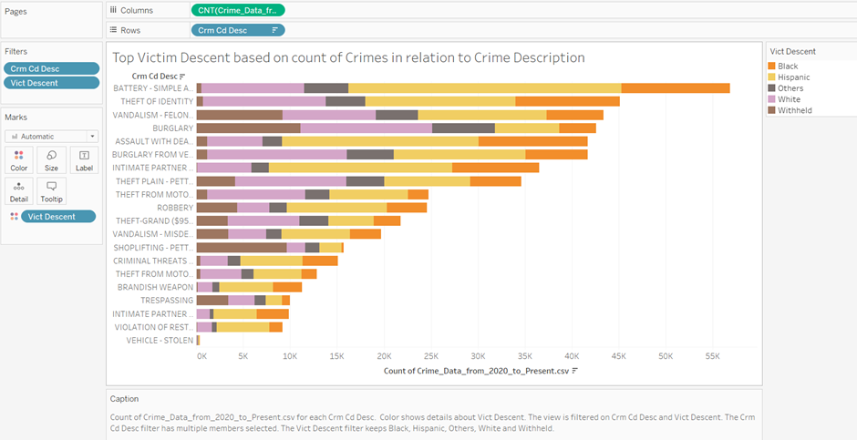
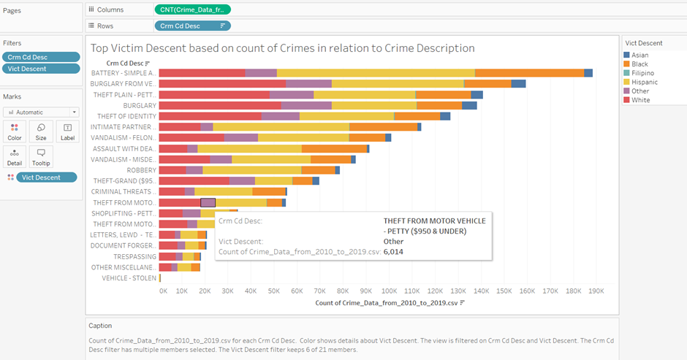
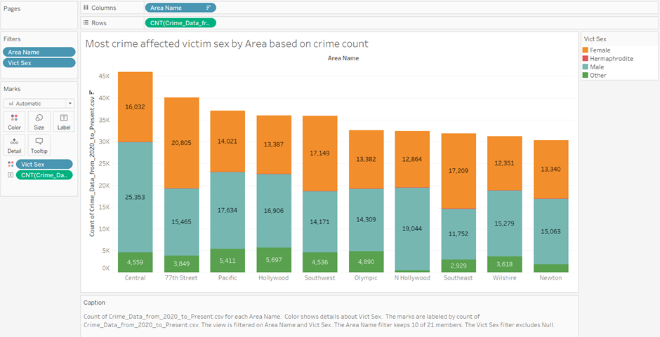
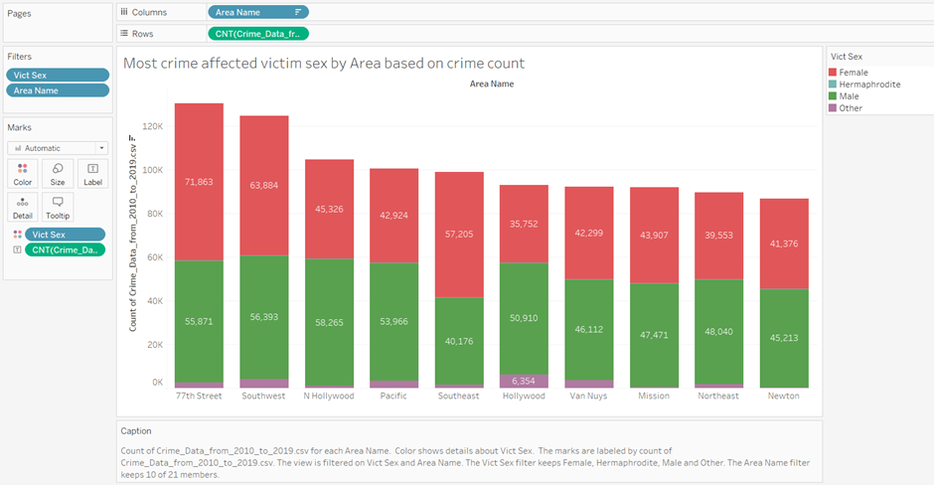
Crime between (2020-Present)
Crime between (2010-2019)

Slide 10
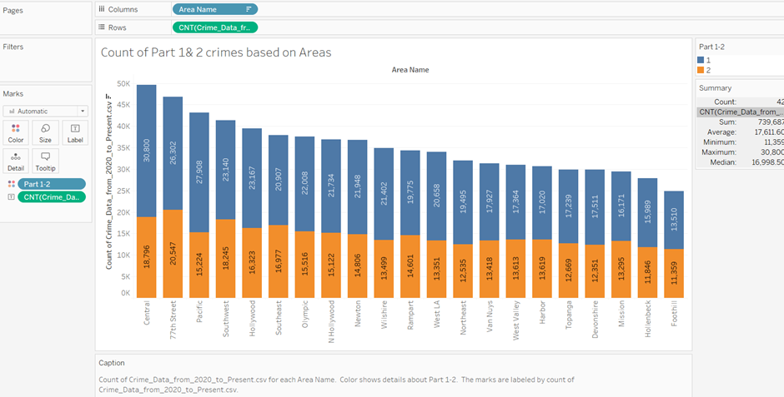
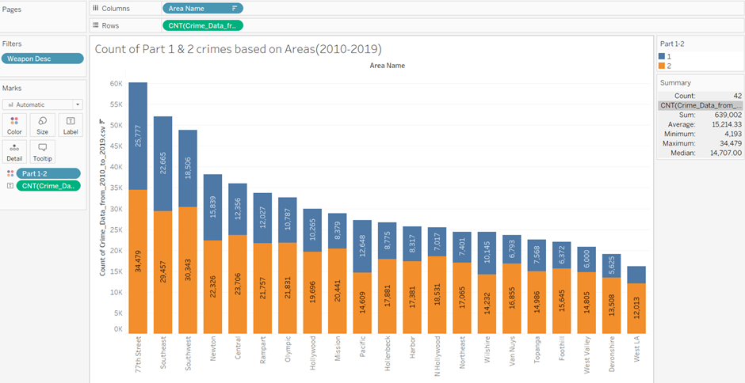
UNDERSTANDING PART 1 & 2 CRIMES:
Part 1 Crimes:
Part 1 crimes, also known as index crimes, are considered serious offenses and are tracked by the FBI's Uniform Crime Reporting (UCR) program. Part 1 crimes have a higher priority for law enforcement
Part 2 Crimes:
Part 2 crimes include less serious offenses or violations that may not fall under the UCR program's specific criteria for Part 1 crimes. These crimes can vary by jurisdiction but typically include offenses such as simple assault, fraud, drug offenses, vandalism, disorderly conduct, and other non-index crimes.

Slide 11
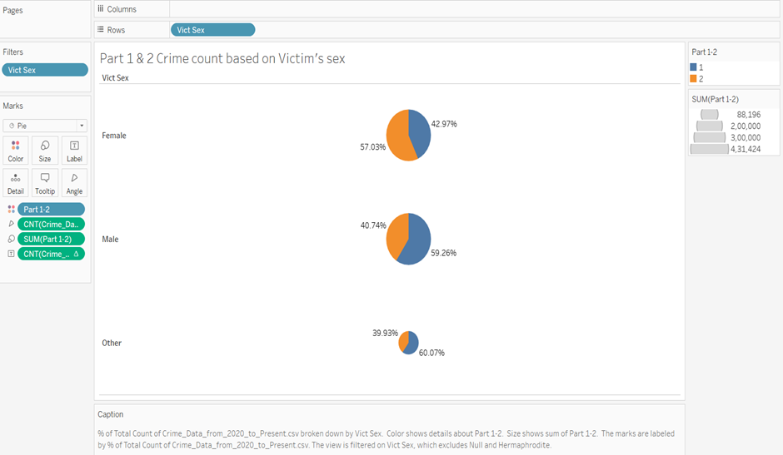
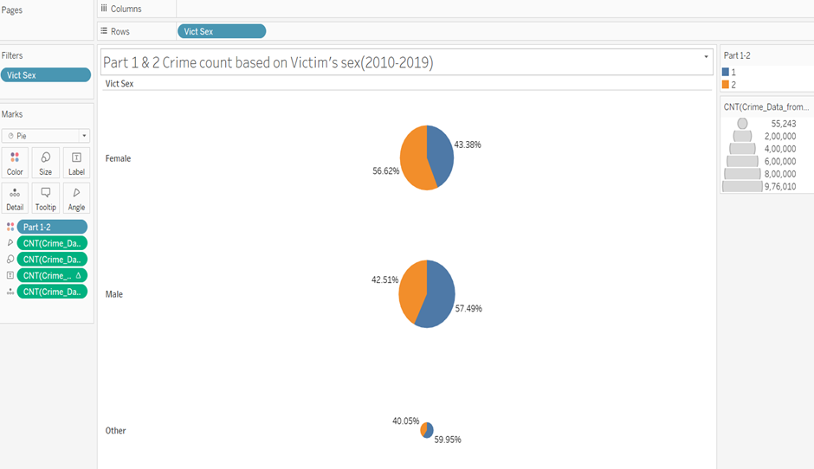
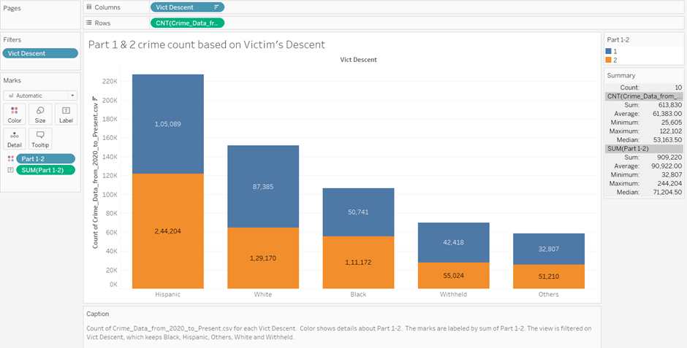
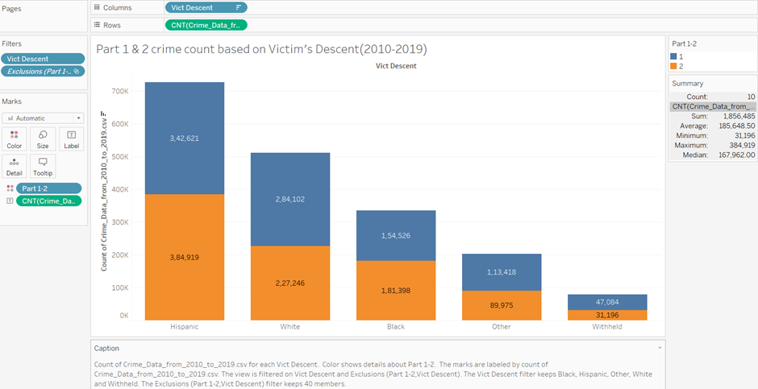
Crime between 2020- Present:
Crime between 2010-2019:

Slide 12
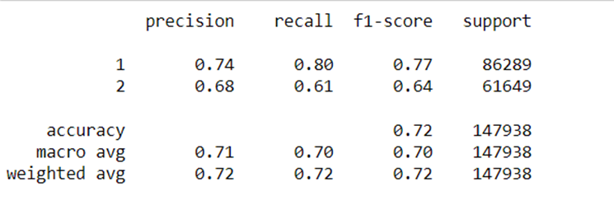
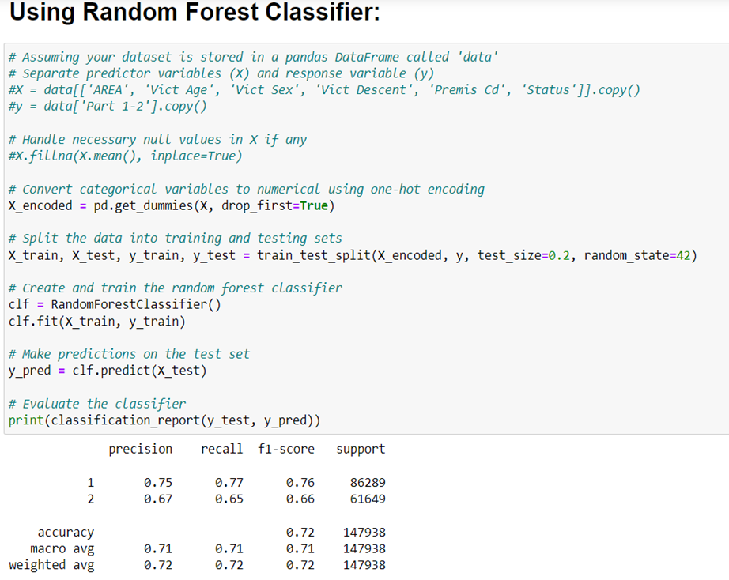
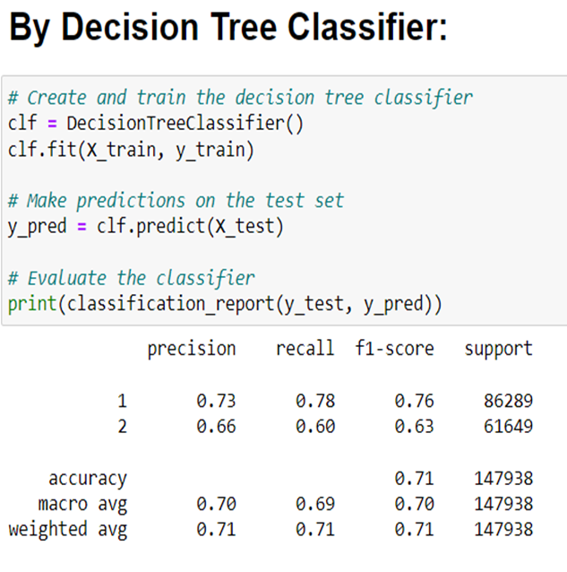
CLASSIFICATION OF PART 1 & 2 CRIMES:
CLASSIFICATION REPORTS:
The accuracy of all the 3 algorithms is similar around 71-72 percentage.
LOGISTIC REGRESSION:
RANDOM FOREST CLASSIFIER
DECISION TREE CLASSIFIER:

Slide 13
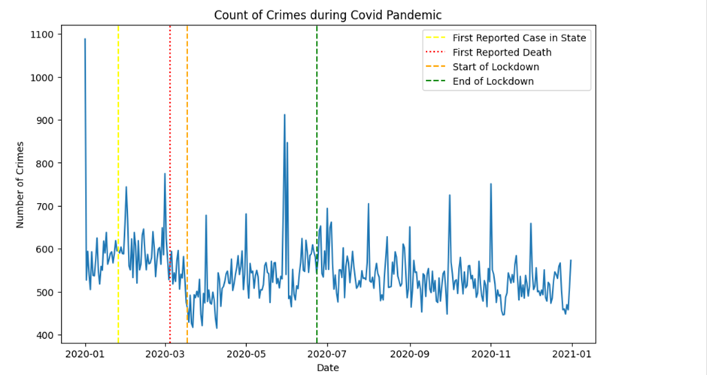
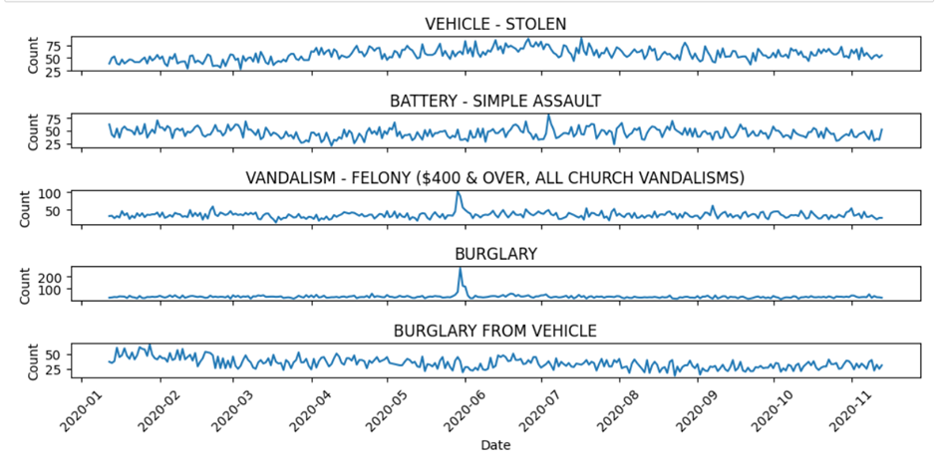
Impact of Global Events on Crime:
Covid-19 Pandemic:
Top 5 crimes progression during pandemic:

Slide 14
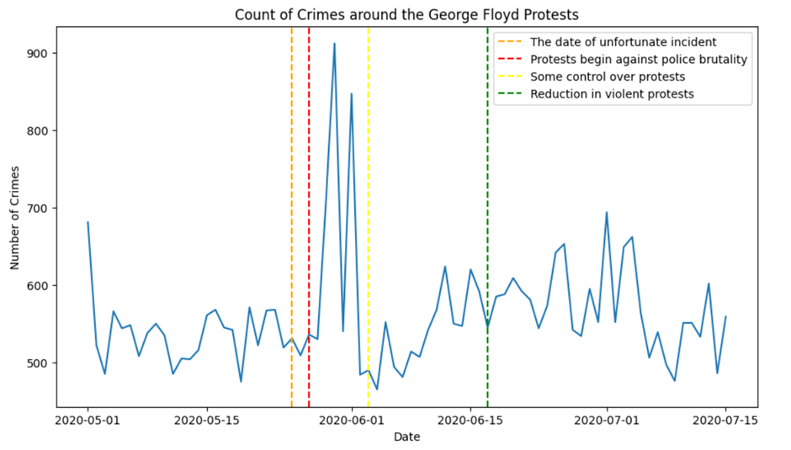
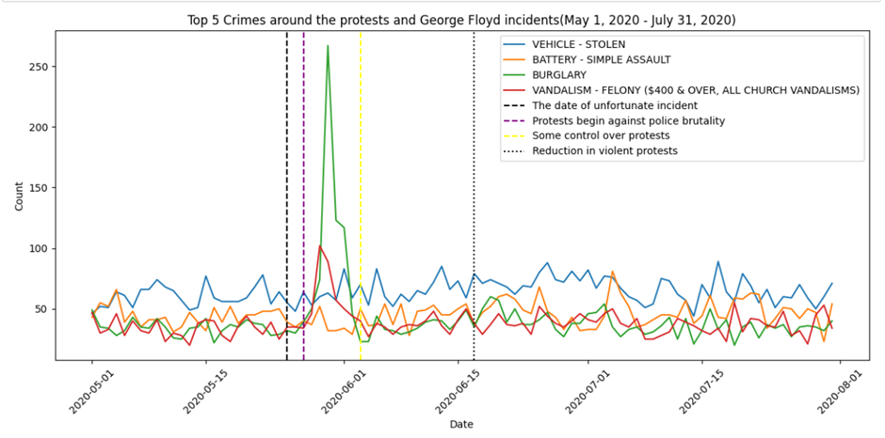
George Floyd Protests:

Slide 15
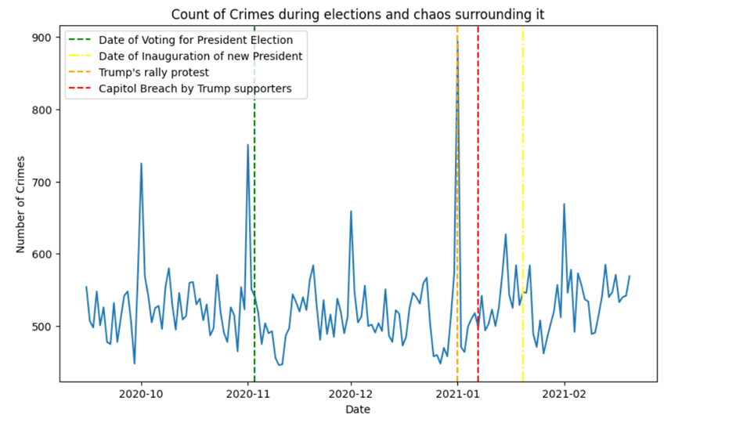
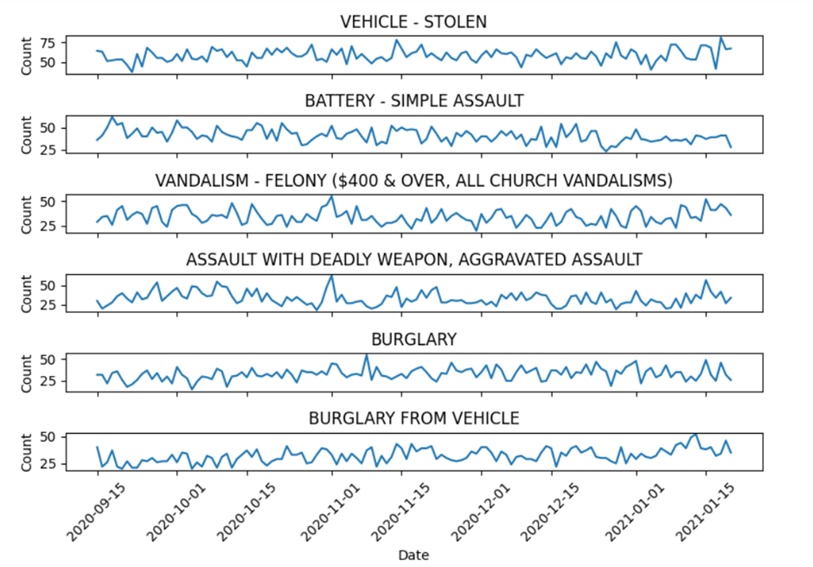
2020 US Presidential Elections
Top 5 crime progression during 2020 Elections:

Slide 16
Major Observations:
Security should be tightened around noon and evening when most number of crimes happen.
Central Area has witnessed huge increase in crimes in recent years. Single Family Dwellings from 77th Street are most unsafe area by count of crime.
The progression of crime rate during 2010-2019 was stable, which was decreased abruptly due to the pandemic in 2020. The crime rate is coming back to normal progression since 2021-2022.
Female sex is a major victim of Strong arm attacks(hands, body force) whereas Males are victims of gun violence.
77th Street , Southwest and Southeast are dangerous areas for Female Sex
White People are hugely affected by top crimes like different types of Burglary, Theft and Vandalism.
Central, Pacific areas have witnessed rise in Part 1 crimes hence Police in this area needs to be well equipped.
Males are major victims of Part 1 crimes whereas Females are victim of Part 2 crimes.

Slide 17
Potential of Crime Analysis:
Law Enforcement
Policy and Decision Making
Research and Academia
Real Estate and Urban Planning
Crime Reporting and Media
6. Community Engagement

Slide 18
CONCLUSION:
In conclusion, the LA crime data project has provided valuable insights into the patterns and trends of criminal activities in Los Angeles. Through comparative analysis and basic exploratory data analysis (EDA), we have gained a deeper understanding of the distribution and characteristics of Part 1 and Part 2 crimes. We were also able to understand the impact of Global events on crime rate.
The project emphasizes the importance of accurate crime data collection, analysis, and classification in effective law enforcement, resource allocation, and policy development. The findings can assist law enforcement agencies and policymakers in developing targeted strategies and initiatives to address specific crime categories and enhance public safety in Los Angeles.

Slide 19
Thank You

